Slide 1
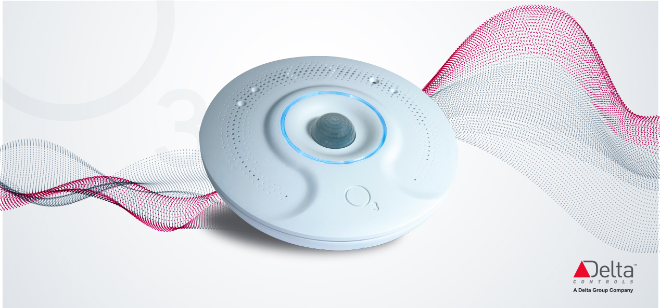
Rev 5
Notes:
Delta Controls is an industry leader in Building Automation Systems, from sensors to enterprise grade data management systems, Delta Controls remains a leader in innovation and product development in the HVAC and building automation control industry. The drive to innovate and differentiate resulted in the sensor rich design of the O3 Sensor Hub 2.0 where machine learning techniques applied to multiple sensors are capable of providing more accurate, faster and smarter feedback of the conditions of a monitored space. The O3 Sensor Hub 2.0 joins the estimated 38 Billion devices in 2020 as an IoT pioneer in the building industry. Sensor data and pre-processed analysis of the space are reported to a cloud platform available for analysis and processing from almost any system.

Slide 2
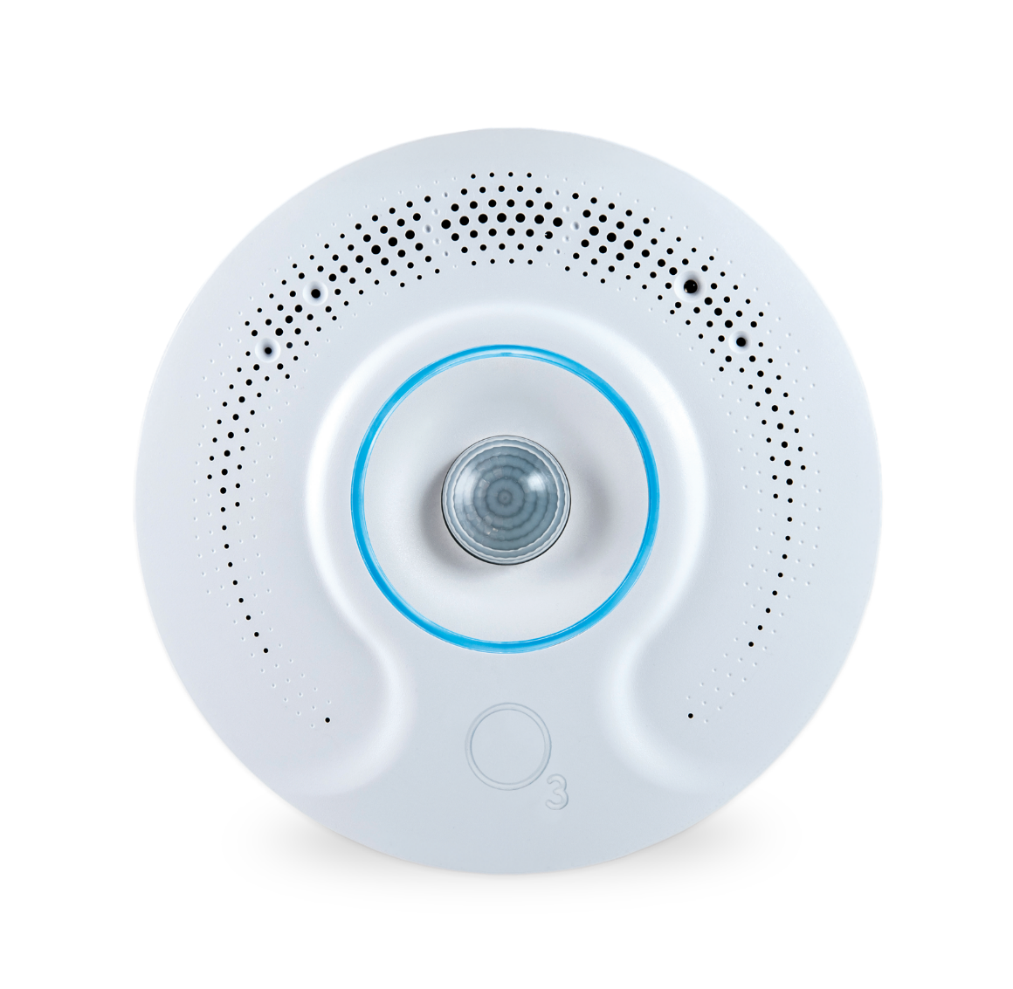
New Product
“To become the industry standard between room engagement and building Services.”
The Sensor Hub 2.0 is an open platform - with multiple interfaces, it is possible to communicate with and integrate into almost any system.
Notes:
Internet of Things (IoT) standards and security infrastructure are at an optimal stage for widespread deployment of IoT systems. IoT devices are predicted to reach 38 Billion in 2020 equating to a $581B industry. The sensor suite of the Sensor Hub and convenient installation location has positioned the Sensor Hub 2.0 as an ideal device for smart buildings.
In 2020, smart buildings will be one of the largest vertical markets for IoT in terms of revenue at 16.8 percent of the market. In contrast, consumer electronics, which has dominated this industry are only set to take 17.9 percent of the $581B market.
In order to achieve widespread adoption as a standardized IoT device, interoperability with other systems was considered as a critical component in its design. Standardized hardware interfaces as well as software APIs were integrated into the Sensor Hub 2.0 platform. The intent is that integration with cloud services and publicized APIs will facilitate rapid development of applications and fuel new business models allowing Delta to become the industry leader of IoT in Buildings.

Slide 3
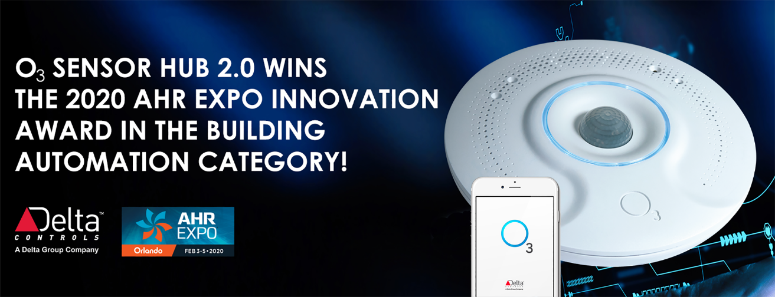
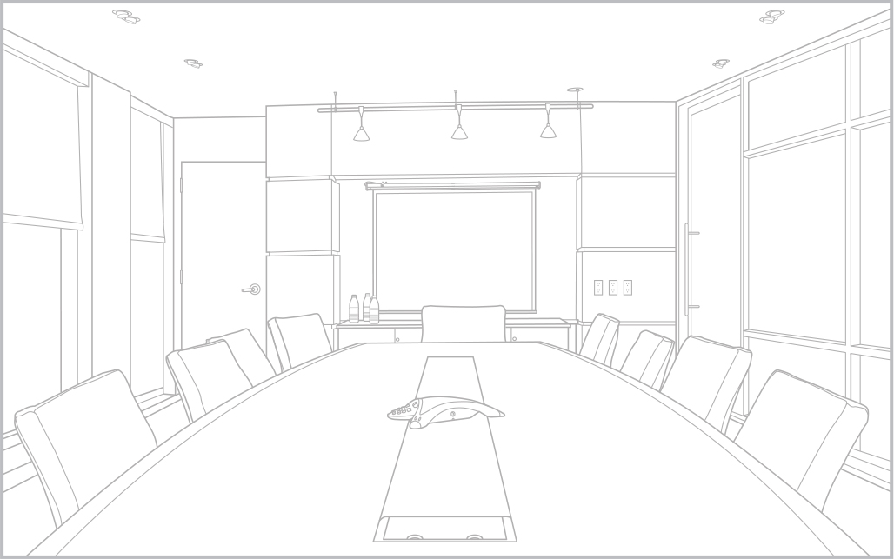
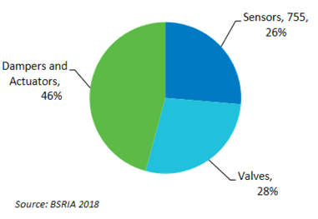
O3 Sensor Hub 2.0 The Product
OBSERVE & REPORT The O3 Sensor Hub will observe its surrounding environment and report it’s findings back to a controller or the supervisory platform.
WHAT IT DOES!
SENSOR FUSION TECHNOLOGY Sensor Fusion Technology monitors over eight space characteristics, then sends a combination of raw and processed data to local controllers and supervisory systems.
CLOUD CONNECTIVITY & USER ENGAGEMENT Virtually touchless installation, setup and commissioning practices combined with unique yet simple user engagement methodologies.
Notes:
The O3 Sensor Hub is a product that observes its surrounding environment and communicates to almost any controller or supervisory platform. To achieve this, it uses our patented Sensor Fusion technology to monitor over eight space characteristics, these characteristics are pre-processed and communicated to any controller, BMS supervisor or cloud database.

Slide 4
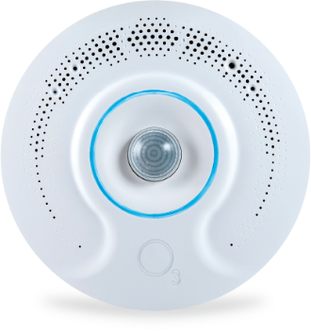
O3 Sensor Hub 2.0 Technologies – What you get!
CONVERGING TECHNOLOGIES
SENSOR FUSION Multiple sensors found in one package – all combined to understand the space environment.
DUAL-PORT ETHERNET Easy installation, High-speed data transfer.
PROVIDING DATA WHERE YOU WANT, WHEN YOU WANT MQTT, Native BACnet, BTLE API, REST API
O3 APP New O3 App for provisioning and commissioning devices quickly and easily
TWO UNIVERSAL I/O Two universal inputs and outputs provide rudimentary control straight from the Hub.
ONBOARD USER FEEDBACK LED ring and audio outputs provide immediate user feedback and/or changing environment conditions.
EMBEDDED METRICS Onboard algorithms used to help identify the operation, functionality, and reliability of the device.
Notes:
Simply put, the Sensor Hub is packed with technology. From hardware innovations such as its embedded sensor clusters (which we call Sensor Fusion) and its dual Ethernet ports all the way to firmware and software enhancements, the product has the capability to get the job done in a range of different configurations and environments.

Slide 5
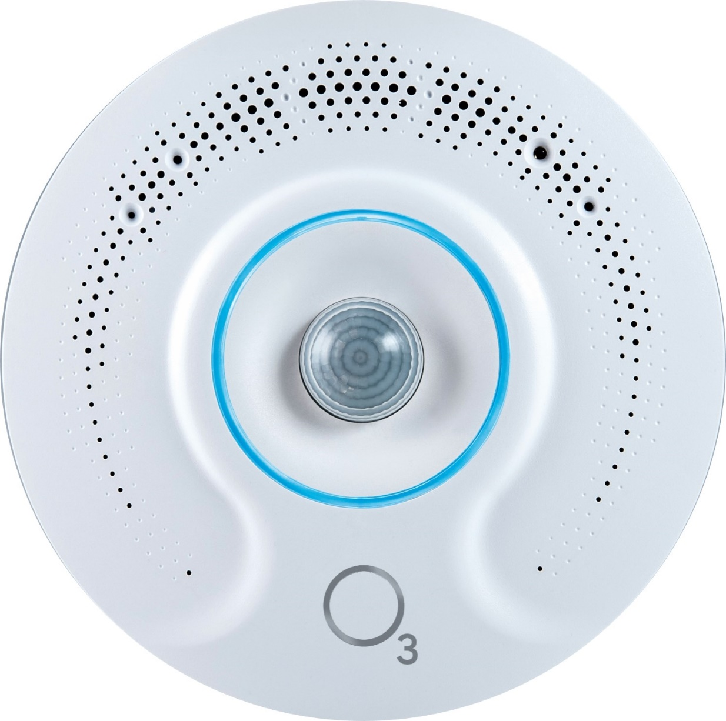
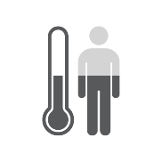
Onboard Sensor Options The Product
Occupancy
(PIR + Audio)
Infrared Temp.
Humidity
Temp.
Audio Output
Light Color
Light Level
LED Ring
Wireless
Wireless
Audio Signatures
IR Blaster
Notes:
The Sensor Hub 2.0 contains integrated sensors and wireless sensors.
Sensors and user interaction will be reviewed in detail.

Slide 6
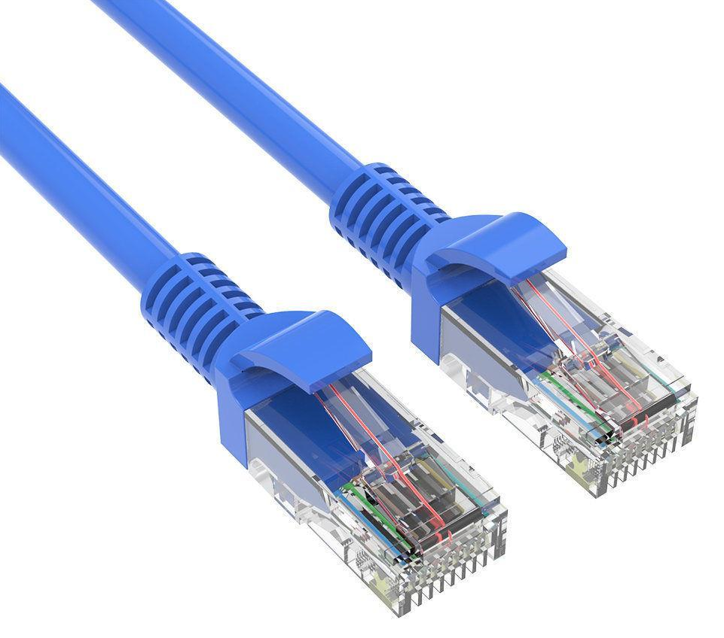
The O3 Hardware
Temperature - local and occupant height. IR and air temperature sensors.
Occupancy detection - algorithm uses PIR motion, audio, and IR sensors
Full BLE communications available - integrate with iOS and Android easily
Humidity - Relative humidity at ceiling and also at occupant height
Audio out - customize sounds play through integrated speaker
Dual ethernet ports - supports BACnet, MQTT, and REST interfaces
Optional EnOcean radio supports connectivity to self-powered wireless sensing solutions for batteryless applications.
(Feature available: 2021Q1)
Light intensity, RGB components, and colour temperature all reported
IR interface - let the O3 control AV and other equipment directly

Slide 7
Temp Sensor Fusion
3 TEMP SENSORS
Combines sensor readings together with machine learning techniques to model temperatures accurately
MACHINE LEARNING
Observes measurements over time to produce predictions that are more accurate than those based on a single measurement.
Notes:
The Sensor Hub uses a series of innovative measurement techniques to obtain temperature and occupancy in its field of view at the occupant’s location approximately 1 m off the floor. The novel algorithm is able to accomplish this using a series of different sensors combined with machine learning techniques used to accurately model temperature in real-time.
Despite the Hub mounted at ceiling height, the device is able to measure temperature at the occupant’s level by modelling temperature based on readings from three internal temperature sensors. Two of the sensors are traditional temperature sensors measuring the ambient temperature at ceiling height, the third is an infrared sensor capable of measuring the large area directly beneath the Sensor Hub. The IR sensor covers an area roughly equivalent to the diameter of the mounted height.
The measurement method uses Kalman filtering where weighted measurements from all three sensors as well as historical measurements are fed into the algorithm in real-time. This method has the added benefit of having the Sensor Hub respond to temperature changes faster than any traditional thermostat while rejecting anomalous readings. Temperature fluctuations are recorded in real-time without being impacted by extraneous events such as somebody walking in the hubs field of view. Consideration of variances in heat sources and airflow in the monitored space are mitigated by performing a simple calibration.

Slide 8
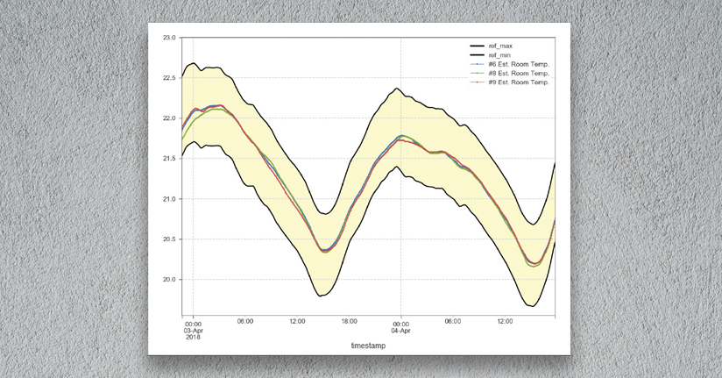
Temp Sensor Fusion
Combining sensor technologies to give better accuracy
IR is 15 minutes faster than a wall-stat
Save energy on occupancy, and vacancy cycles
Calibrate to the desired temperature, at the desired location
Notes:
Lab testing and field deployments have proven the Sensor Hubs temperature sensing method to function superior to any traditional thermostat. Measurements from six high precision temperature sensors recorded temperature in the field of view of the Sensor Hub. The variance of these measurements is indicated by the yellow area in the graph.
After calibration, three Sensors Hubs recorded temperature over time, measurements were recorded in the middle of the variance recorded by the high precision sensors. All three Sensor Hubs tracked each other very well.

Slide 9
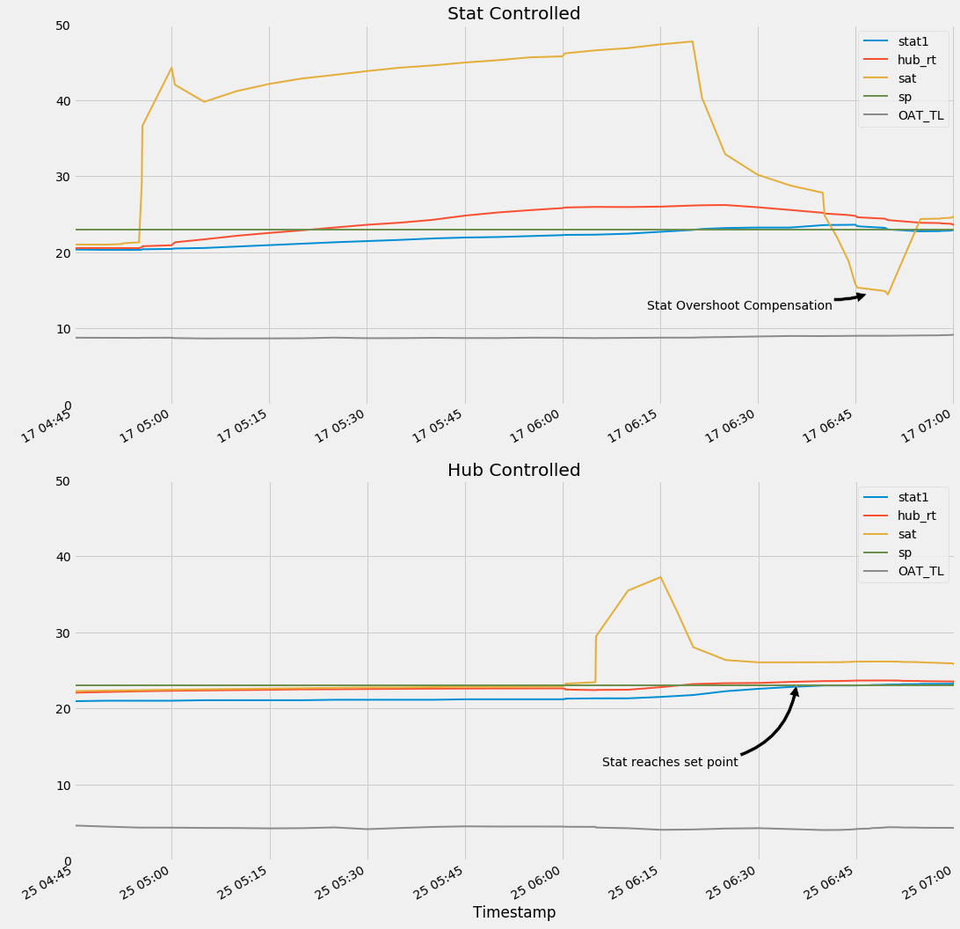
Energy Savings.
Superior Temperature Sensor
Sensor Hub Mounting Height is 4.6m (15 ft)
The yellow plot shows the supply air temperature used to control the temperature in a large open office space.
Both graphs show a pre-heat and how the system responds. The top graph is controlled by the thermostat, the bottom by the sensor hub.
As you can see, the system is active for much less time using the sensor hub, and the total energy savings are significant
After applying supply air at 40C, It took 1 min 15 sec for a traditional thermostat to achieve its its 22C setpoint. The supply air had an undershoot of 15C to bring the temperature back down.
In contrast, the hubs fast reaction only required 38C supply air for 10 seconds and resulted in no undershoot.
The blue plot is the temperature measured by a traditional thermostat in the same space.
The red plot is the temperature measured by the sensor hub in the space
Notes:
After applying supply air at 40C, It took 1 min 15 sec for a traditional thermostat to increase to its 22C setpoint. The supply air had an undershoot of 15C cool air to bring the temperature back down.
In contrast, the hubs fast reaction only required 38C supply air for 10 seconds and resulted in no undershoot.

Slide 10
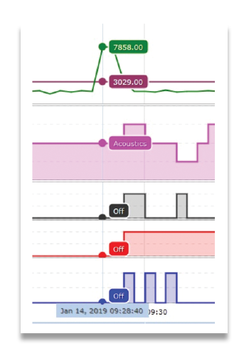
Occupancy Sensor Fusion
3 SENSORS
PIR – check for motion
Microphone – measure noise
IR – heat spikes (I.E. People)
MACHINE LEARNING
Only PIR will trigger occupancy
Sound only considered after occupancy trigger to latch on
Ambient noise filtered out
Notes:
Similar to temperature, occupancy is handled using a combination of a standard PIR motion sensor, thermal IR sensor to detect the presence of human bodies and microphone to further analyze the space for audio conversation and even computer keyboard clicks.
The PIR sensor will trigger immediately upon detection of movement. Through machine learning the ambient noise conditions are filtered out allowing the hub to identify new sounds indicating the space is still occupied. This is further complemented by identifying heat spikes (ie. People)

Slide 11
Sensor Hub Location
Do it right. | deltacontrols.com
Notes:
Example installation of the Sensor Hub used in the Education Market

Slide 12
Sensor Hub Location
Do it right. | deltacontrols.com
Notes:
Example installation of the Sensor Hub used in the Healthcare Market

Slide 13
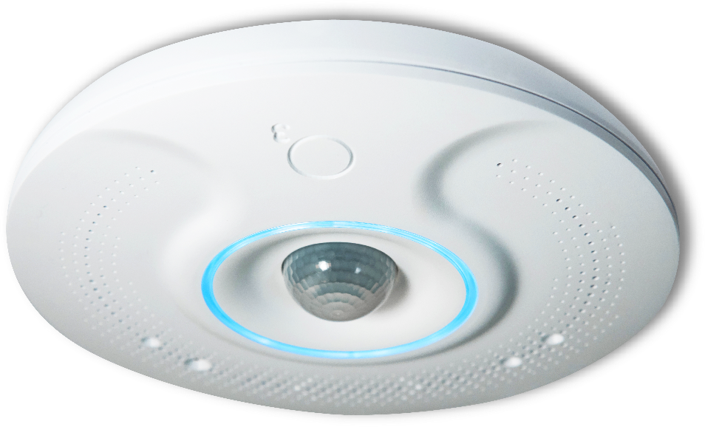
Location
Closer to occupant
Ideal location for:
Avoids indirect sunlight
Occupancy detection
Optimal radio antenna position
Tamper avoidance
Easy to move walls/equipment
Open office cubicles
Solution for wall acne
T-bar vs wall installation
Notes:
Advantages of locating the sensor hub on the ceiling

Slide 14
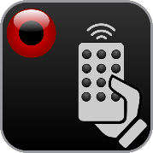
Wireless
IR BLASTER
Sensing and control devices (Send and Receive)
Supports 12 programmable IR codes
Sensing and control wireless/batteryless devices
Window / door contacts
Firmware support available 2021
NFC
Used for setup and configuration when unit is unpowered.
BLE Eddystone-UID Beacon – Indoor tracking applications
BLE 5.0 interface – Used for rapid configuration and custom applications
Notes:
Up to 32 EnOcean devices can be interfaced to a single Sensor Hub. Sensor Hubs can be ordered with enOcean radios however firmware to link to enOcean devices will be available in 2021.
Two way BLE communication available.
Up to 12 IR codes can be programmed in the Sensor Hub and can be programmed to control IR devices in the room.

Slide 15
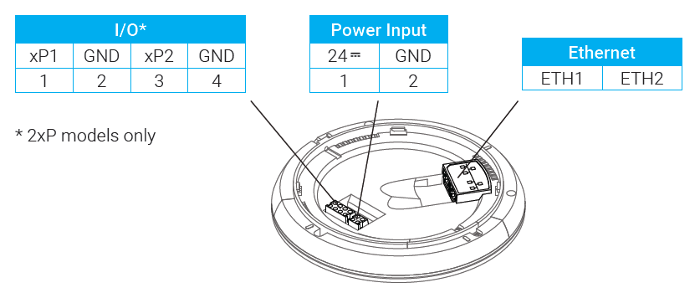
Standard Connectivity
Open Platform Integration With Any System
Open System Using Standard Protocols
Native BACnet communications
MQTT and REST APIs allow for 3rd party development and integration
BLE API for custom app development
Standard Connectivity
NFC
Dual-port Ethernet connection
Bluetooth Low Energy (BLE 5.0)
2 Universal I/O Ports
Dual Ethernet
BLE 5.0

Slide 16
Sensor Hub 2.0 Security
NFC
Ability to lock NFC Read/Writes after configuration
BLE
AES-CCM encryption
Customizable passcode
BACnet/SC
Optional BACnet Secure Connect available
RESTful API
TLS Security
MQTT
TLS Security
Encrypted connection between the MQTT broker and MQTT client using a trusted certificate on the Client
Notes:
BACnet Secure will be available in a future firmware update.
For TLS (REST and MQTT), customer certificates can be written to the Sensor Hub. Customer generated private certificates are encrypted using the Hub's public key.
NFC is used to read/write network settings even when the hub is not powered. The NFC can be locked from read/writes from the NFC app.
BLE uses AES-CCM encryption and a 6 digit customizable passcodes.

Slide 17
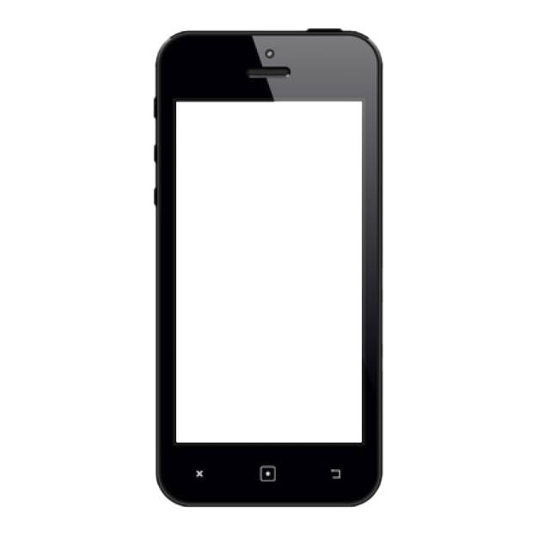
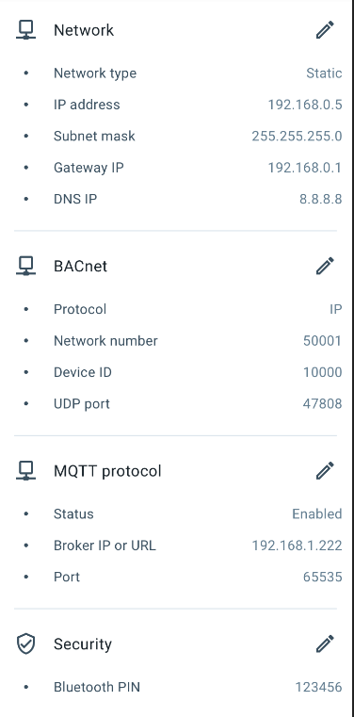
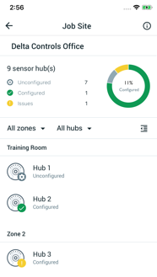
O3 Setup Lite App
Simplify the Installation/Setup Process • Set IP and BACnet networking addresses
• Calibrate temperature and light sensors
• View sensor readings and diagnostic data
• Initiate firmware updates
Synchronization with web configuration tool coming in 2021
Notes:
Web commissioning tool that was tested during the field trial will be released in 2021. The purpose of the web configuration tool is to make the installation and configuration as fast and simple as possible. This is accomplished using the web configuration tool that allows building engineers to setup and configure the hub network in the Cloud and have the configuration linked to the hub via the mobile setup app.
The O3 Setup Lite is a version that does not use the cloud provisioning tool.

Slide 18
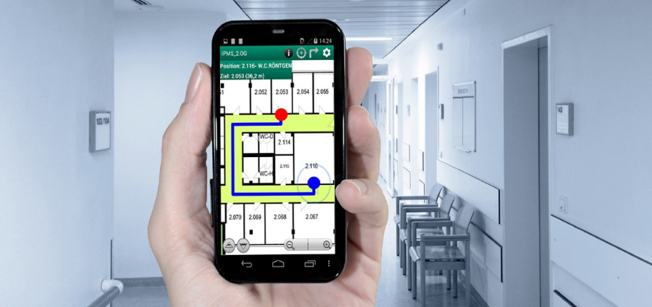
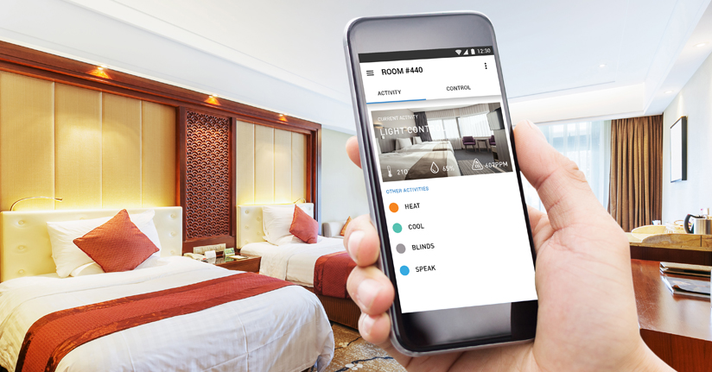
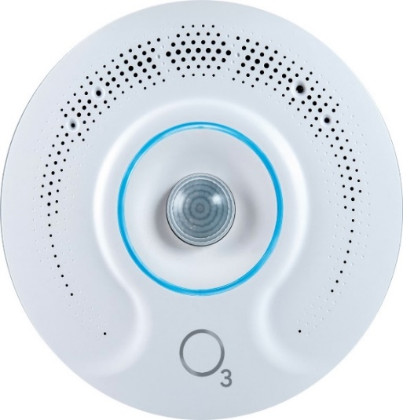
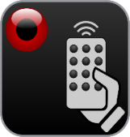
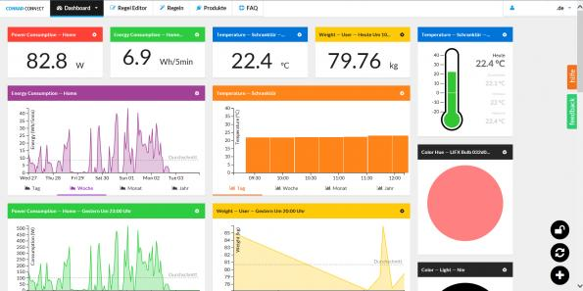
Custom App Development
Occupancy
PIR | Audio | IR
Temperature
IR | Thermistors
IR Blaster
Light Color
Light Intensity
Humidity
Audio Level
Bluetooth
Beacon
Notes:
IoT Connected Sensors provide platform for custom app development and feature rich applications.
Open protocols and published API’s available for custom app integration and development

Slide 19
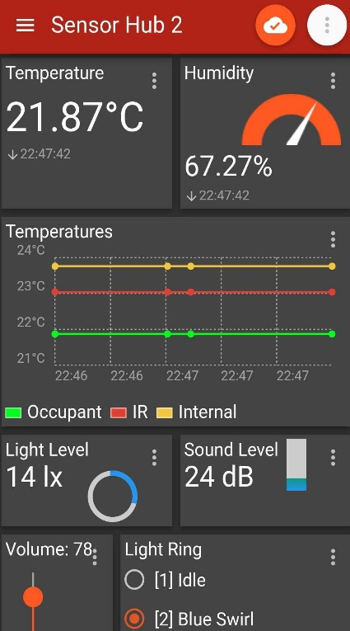
Example Applications
Integration with IoT MQTT Panel
Integration with Google Home/Alexa
Notes:
Using MQTT integrations with 3rd party apps, dashboards and systems is possible.

